Slide 1

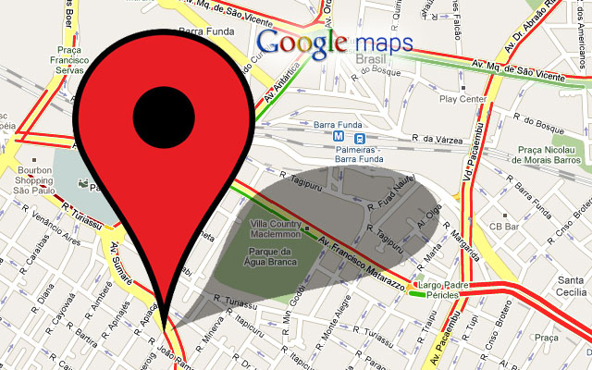
Industrial Workshop
Traffic real-time ripple system with crowd-sourcing platform

Slide 2
Understanding cities — their neighborhoods, zones, dynamics, and relationships — has a long history in architecture, urban studies and urban planning. We developed different paradigms for how to understand and shape the patterns of urban life in KL.

Slide 3
Recently,
Development of data-driven increased almost triple since 2012, approaching urbanism purposes.
Big data becomes a solution for current development after advanced computational techniques grow to find useful information or pattern.
Thanks to NVidia for general Aid graphics for concurrency calculating, we now can mining Big Data efficiently.
Not just for that, Artificial Intelligence also becomes a rage for any industries and a must to have it at least on a single system.

Slide 4
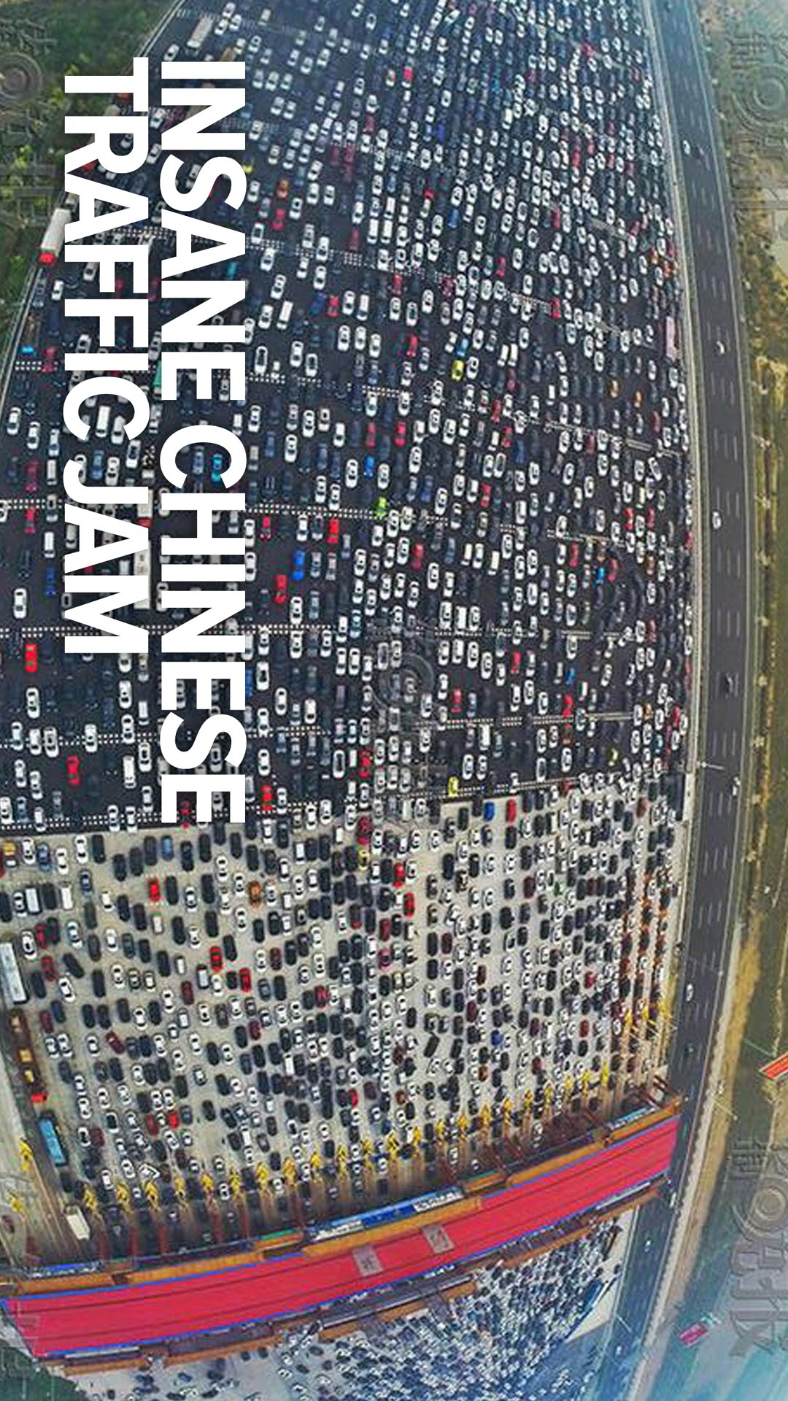
Main problem
Malaysia do not have a data centre to process the raw big heavy traffic data they accumulated every single segment road, every single day.
Government and Private agencies not be able to predict incoming traffic or fluid of the traffic in Malaysia.
So what is the benefit collaboration collecting heavy traffic data with OpenTraffic, right?

Slide 5

This inspiring work reveals that marrying data-driven thinking with urban theory can radically re-shape the way we understand, improve and transform cities in the future — as businesses, governments, citizens.

Slide 6
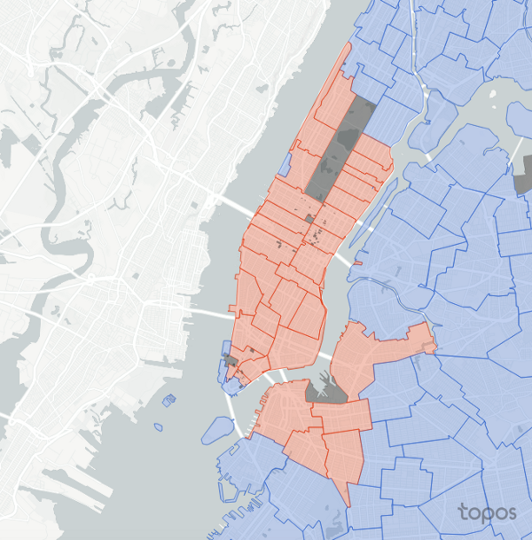
What is our solution?
This is not KL.

Slide 7
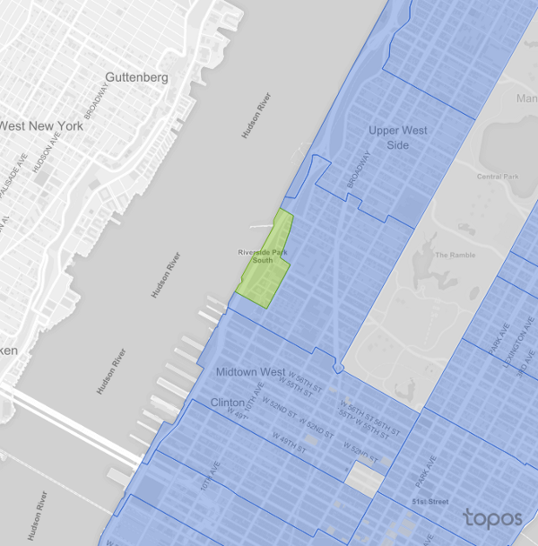
We want to predict nearby traffic fluid flow when choosing a location.
But how does we do this?
Bayes Theorem.
Probability of event A on event B.
This is not KL.

Slide 8
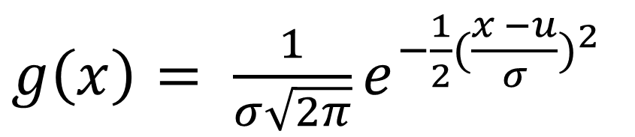

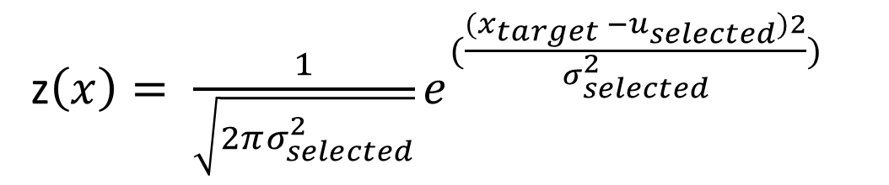
$$Bayes Theorem P\left(A \right|B)=\frac{P\left(B \right| A) ∗P(B)}{P(A)}$$
But how to get the probability if we only have Mean and Variance from the sample data set?
Gaussian Function.
Applying Gaussian to Bayes.
$g\left(x\right)= \frac{1}{σ\sqrt{2π}}e^{−\frac{1}{2}{(\frac{x −u}{σ})}^{2}}$
z$\left(x\right)= \frac{1}{\sqrt{2πσ_{selected}^{2}}}e^{{(\frac{{(x}_{target} −u_{selected})2}{σ_{selected}^{2}})}^{}}$

Slide 9
45
40
5
55
21
14
25
12
35
This is just an assumption.

Slide 10
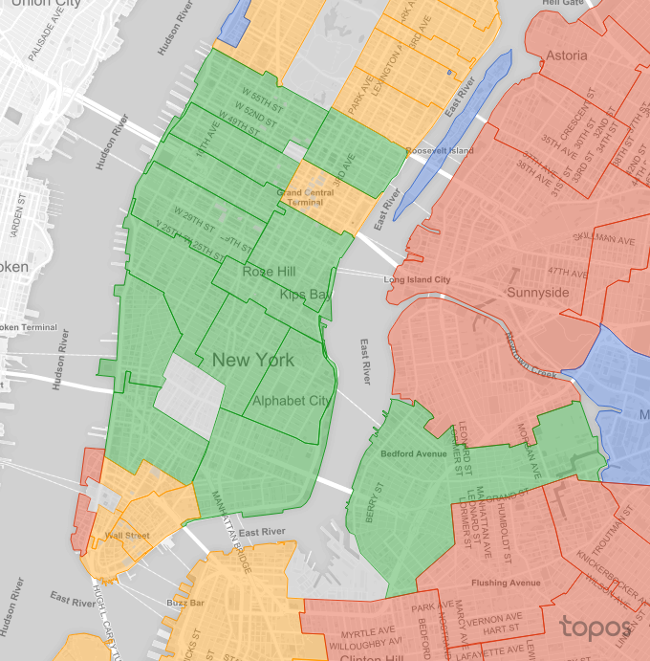
This is not even KL.
This is not even KL.
This is not even KL.
This is not even KL.
This is not even KL.
This is not even KL.
This is not even KL.
This is not even KL.
This is not even KL.

Slide 11
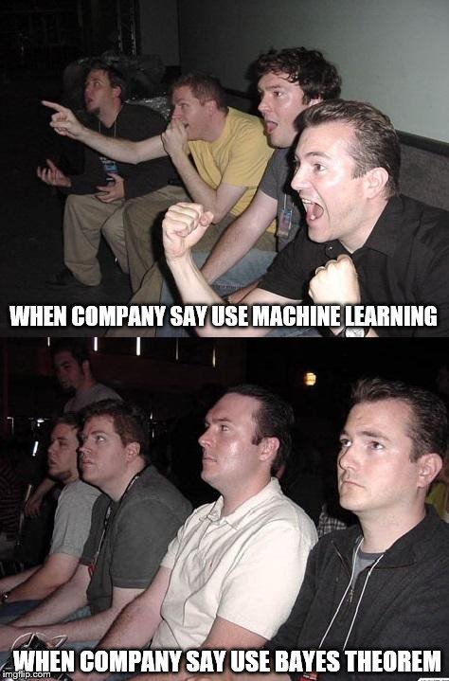
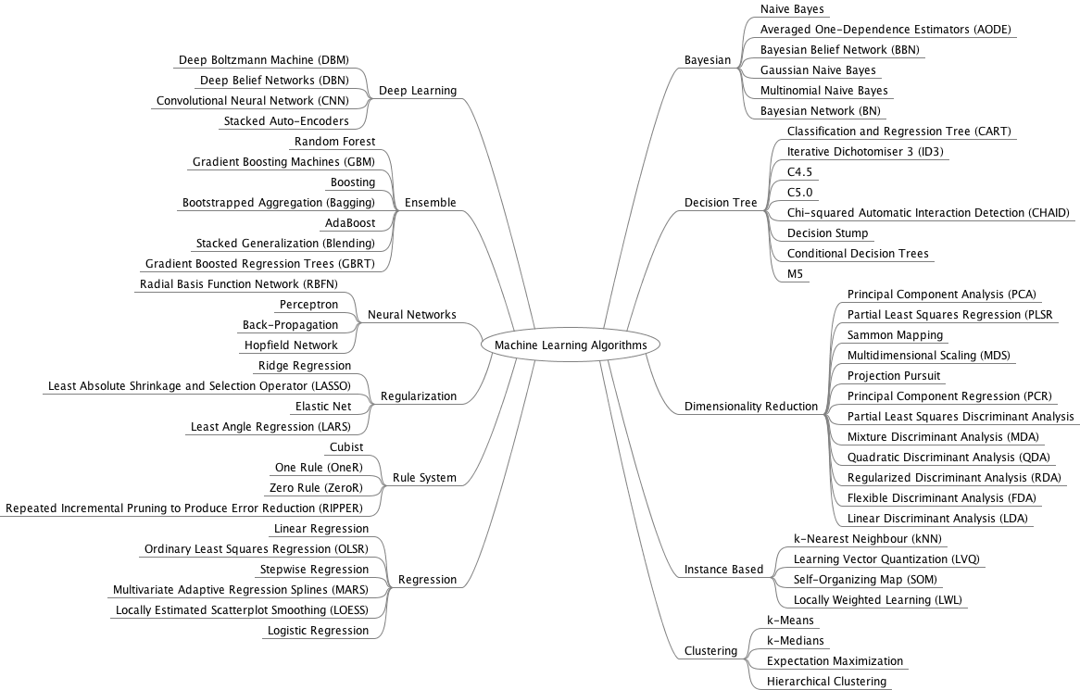

Slide 12


So how about our data?
We got from OpenTraffic. Thanks to ADAX, and GRAB.

Slide 13
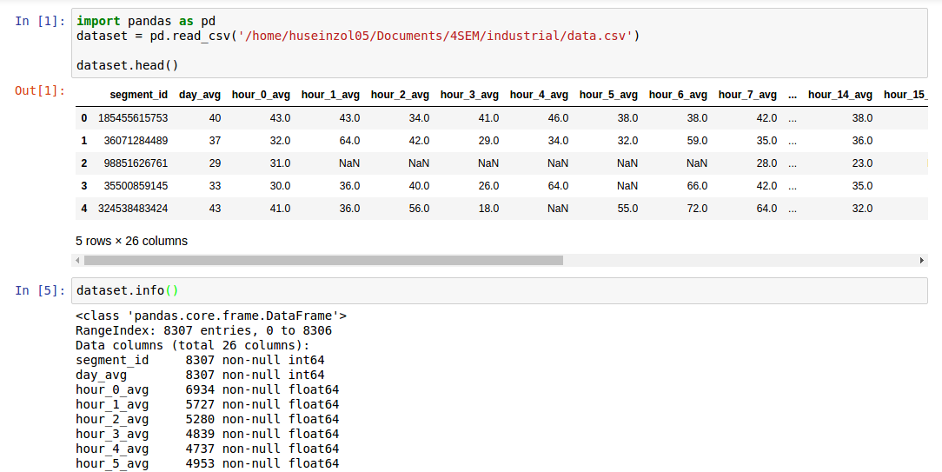
But, we only got data on KL segments on first week of January and February 2016, and the samples given are the velocity of the each segments

Slide 14
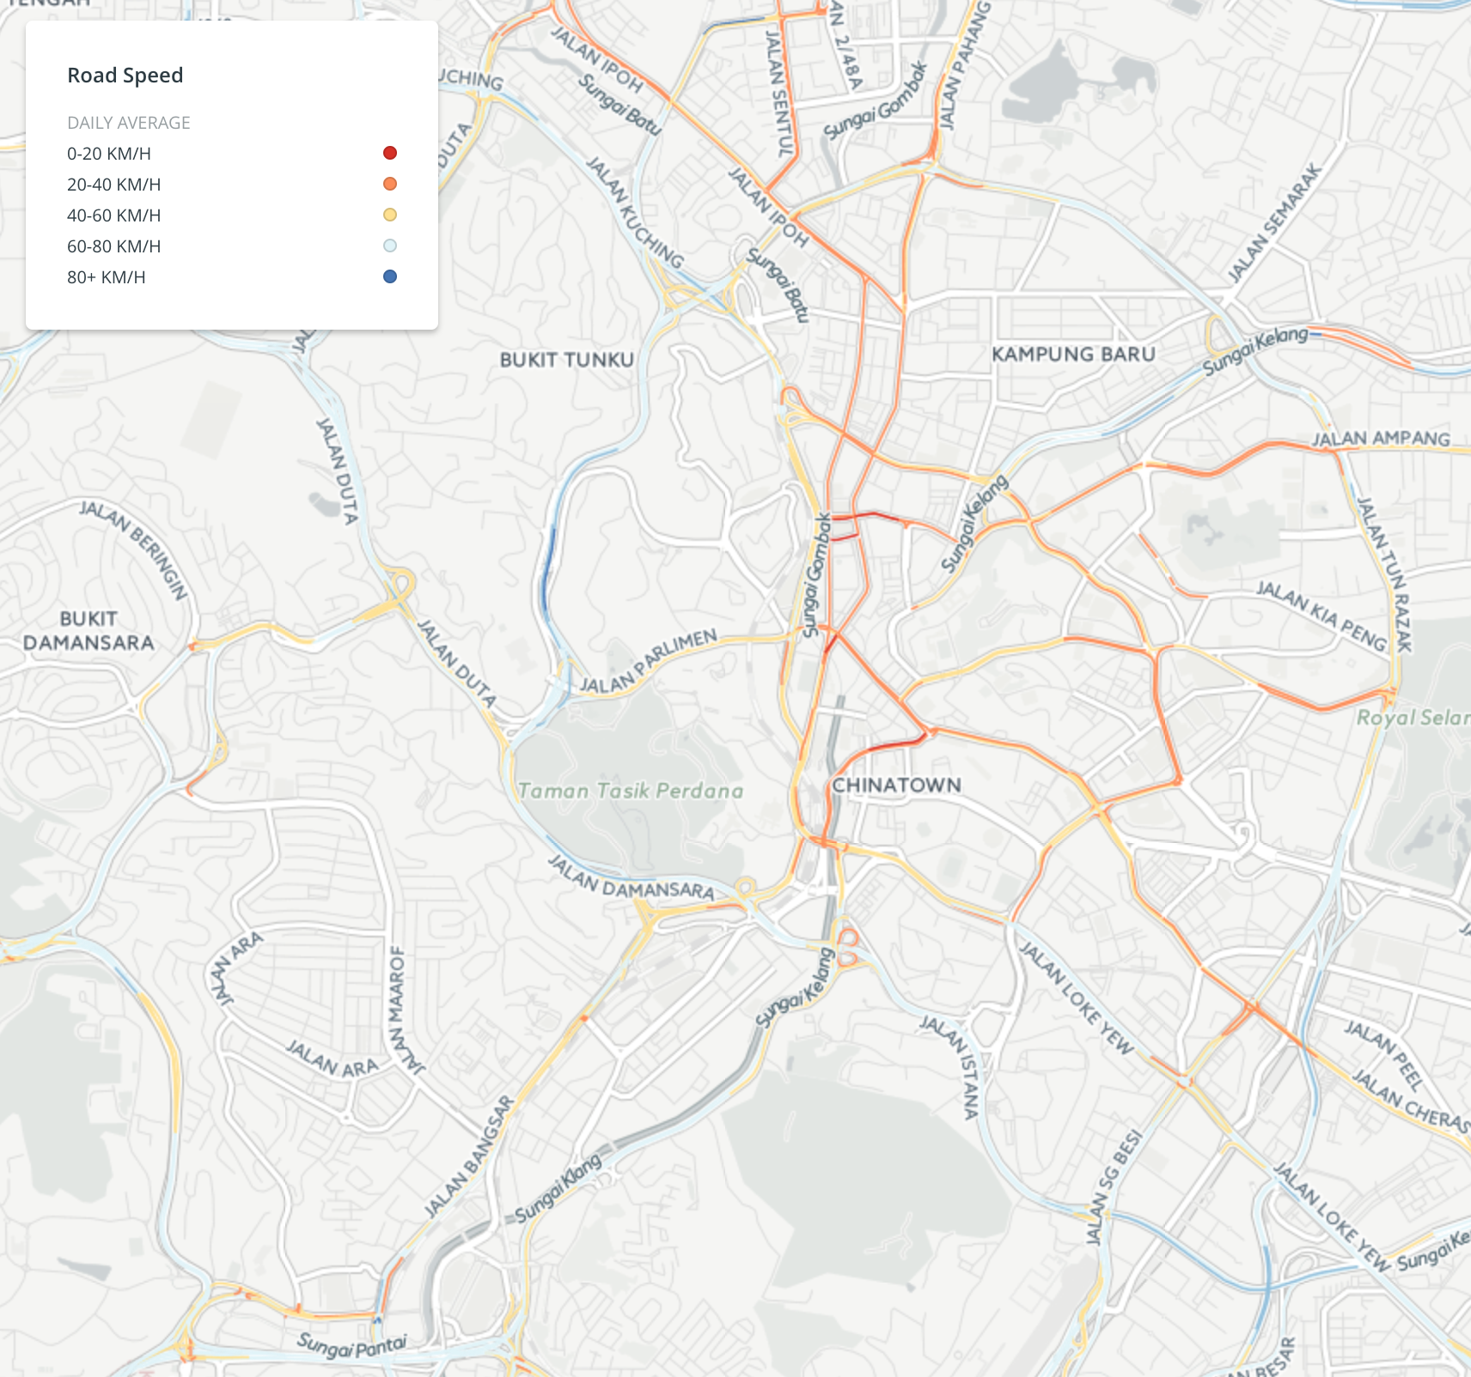
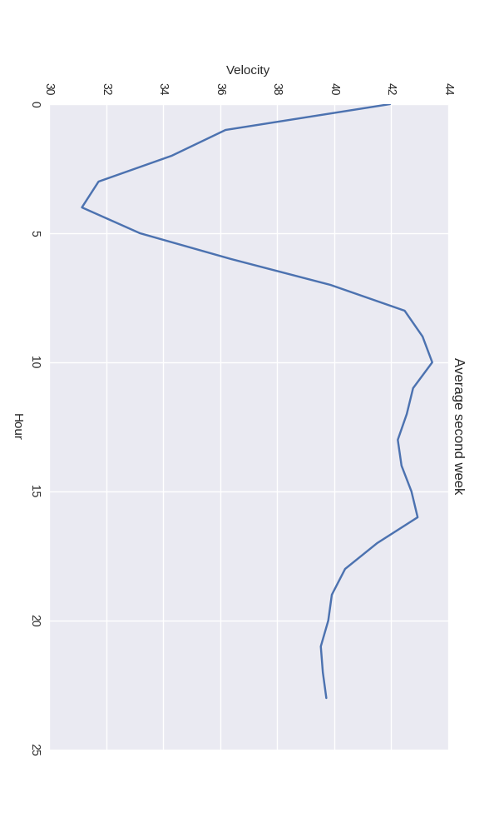
This is KL.

Slide 15
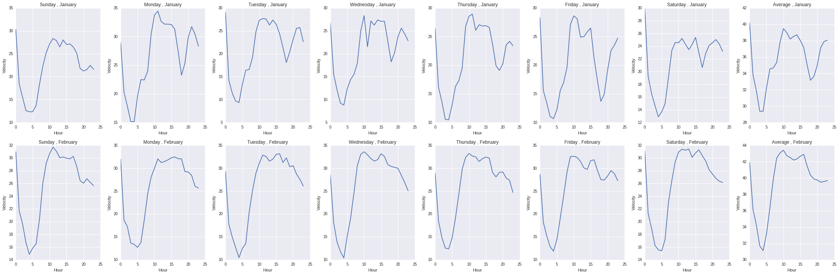
You can get the code and full resolution HERE

Slide 16

Oh, wait, Traffic jam on 4 pagi? Nevermind.

Slide 17

*Need to punch in at 10 am, go out 9.30 am, no jam.
OpenTraffic Logic.

Slide 18

Balik keje be like at 18 o’clock*

Slide 19
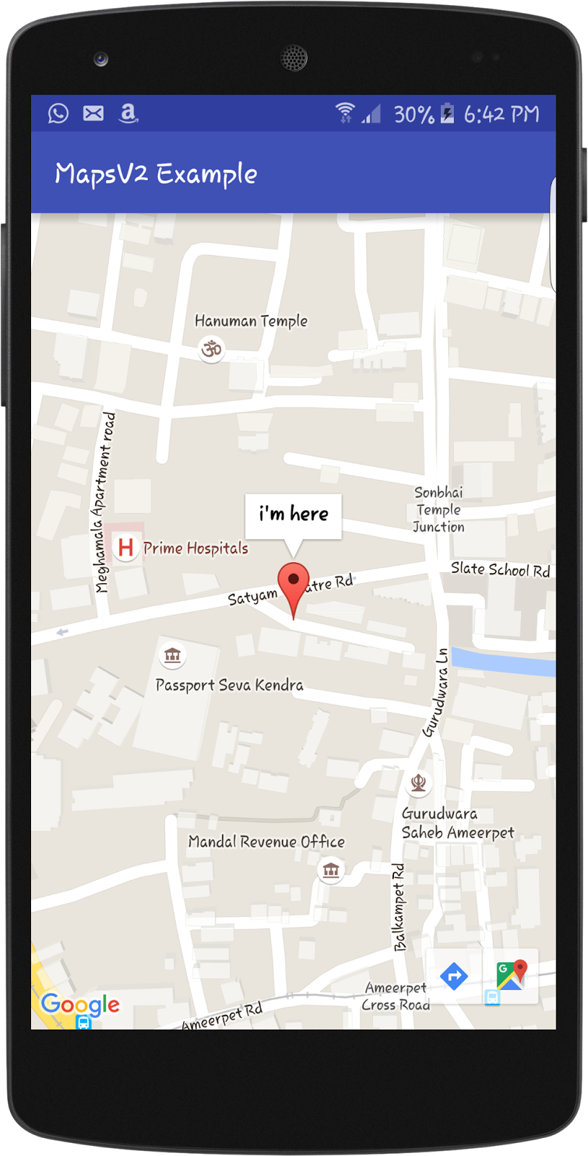
So who is our end user?
Government and private traffic sectors that manage or collect data for fluid traffic flow.
What is traffic sector?
The enterprises that perform traffic and transportation services, but rather also all non-traffic subjects that in some way enable and insure the realization of the transportation service.
This is an illustration, we are creating Web based platform

Slide 20
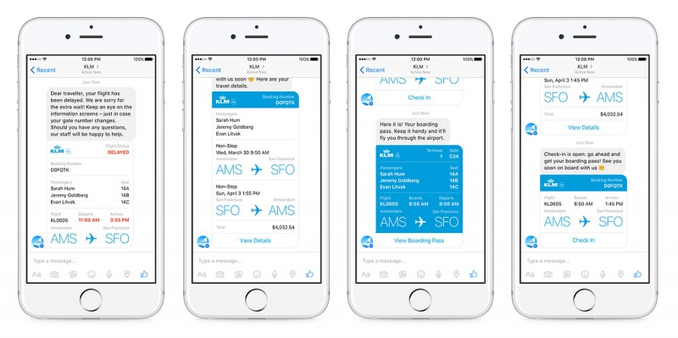
How about the crowdsourcing system?
Facebook Chatbot. Traffic centre can get information when crowd using this system to share the traffic details, and automatic catch the location.

Slide 21
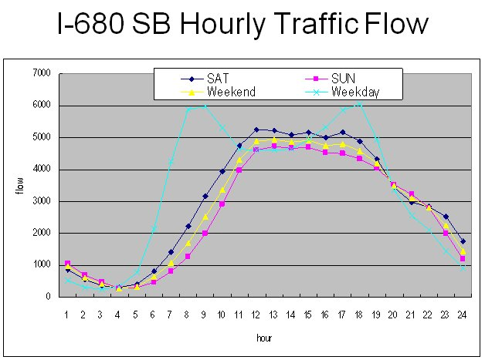
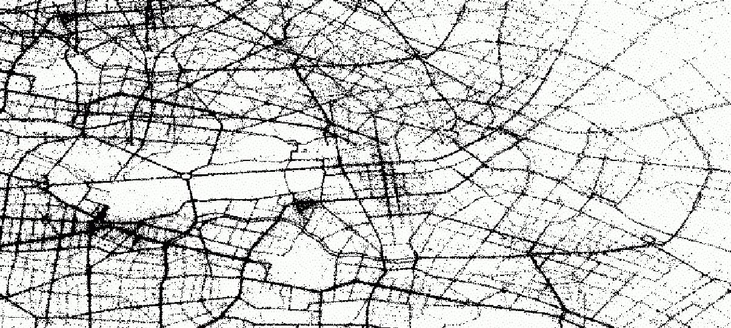
Assumption
1- Able to predict surrounding traffic
due to big data given for every segment road in KL, it may able to visualize traffic flow system, at least.
2- the system only a guide for the agencies
ripple system only predict based on stochastic probability pattern, the real world may not occur

Slide 22
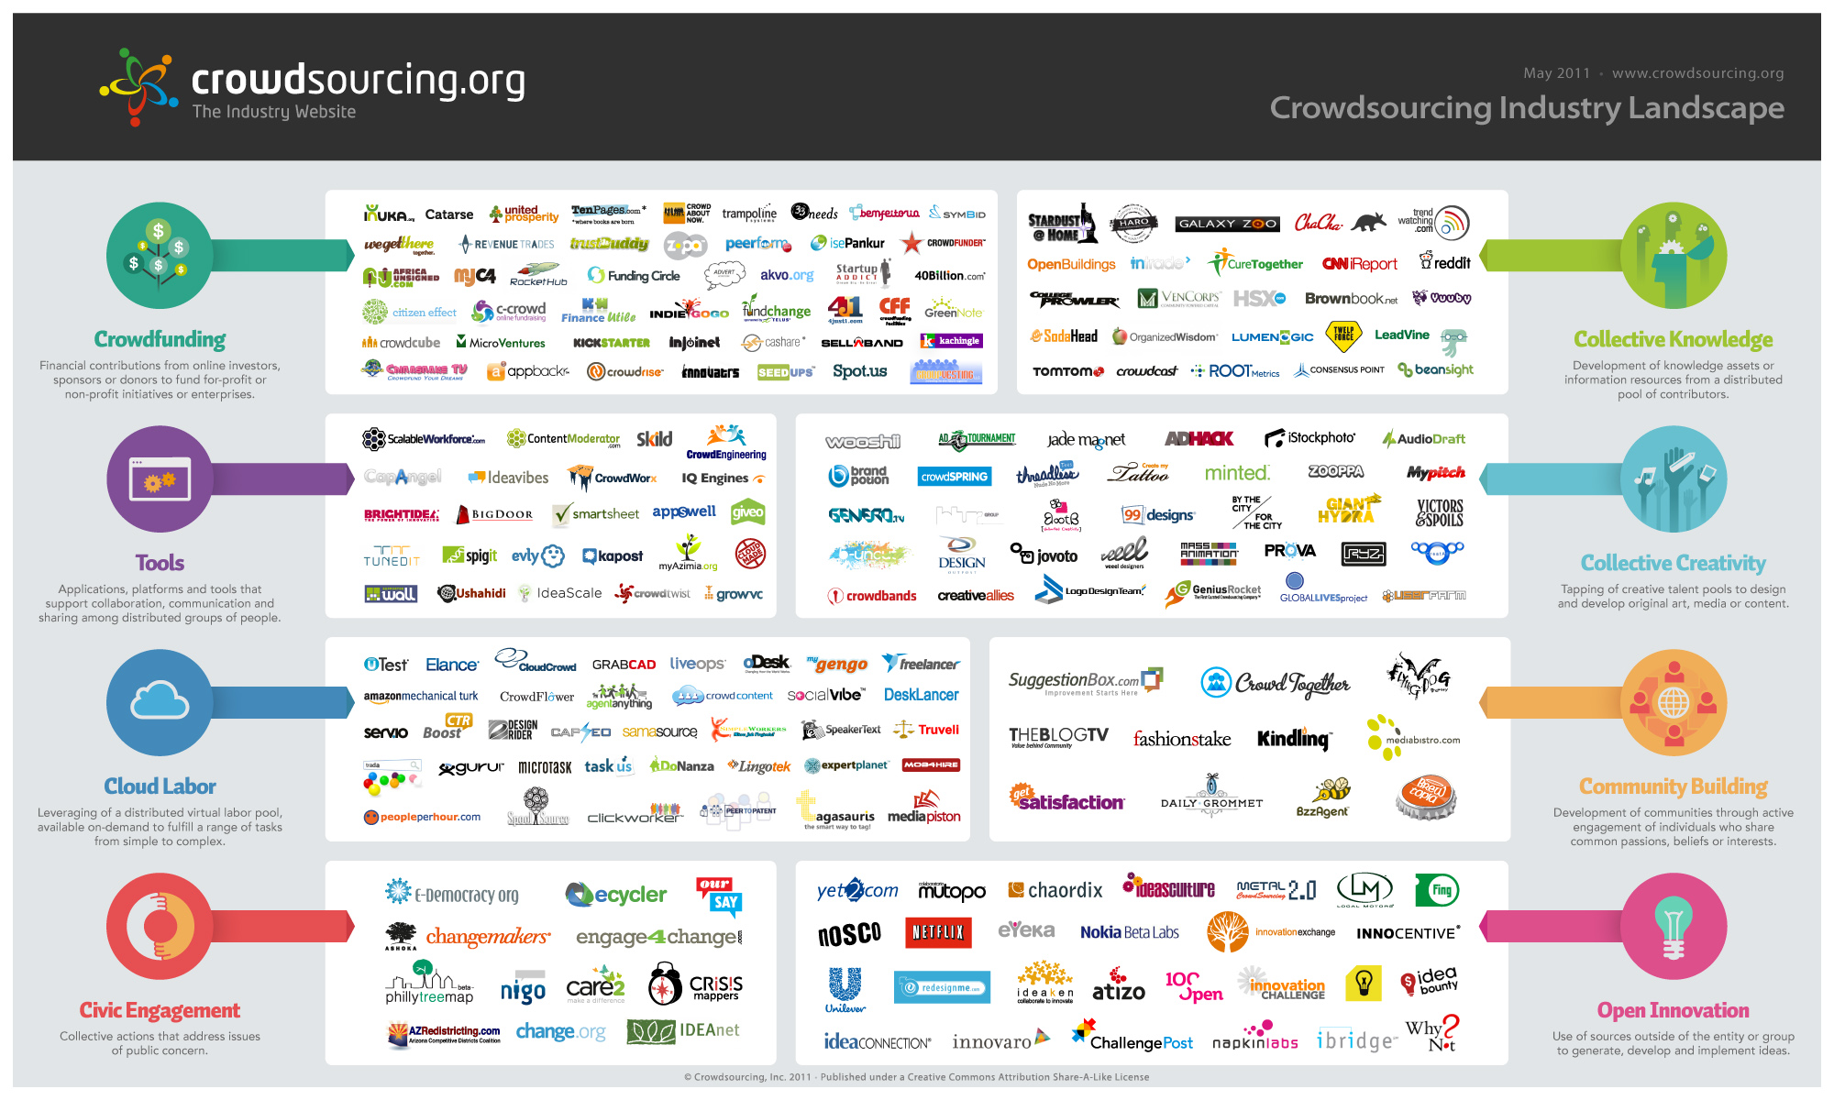
3- The system will store useful data from the crowd
We assume the crowd will contribute useful data during the sourcing process

Slide 23
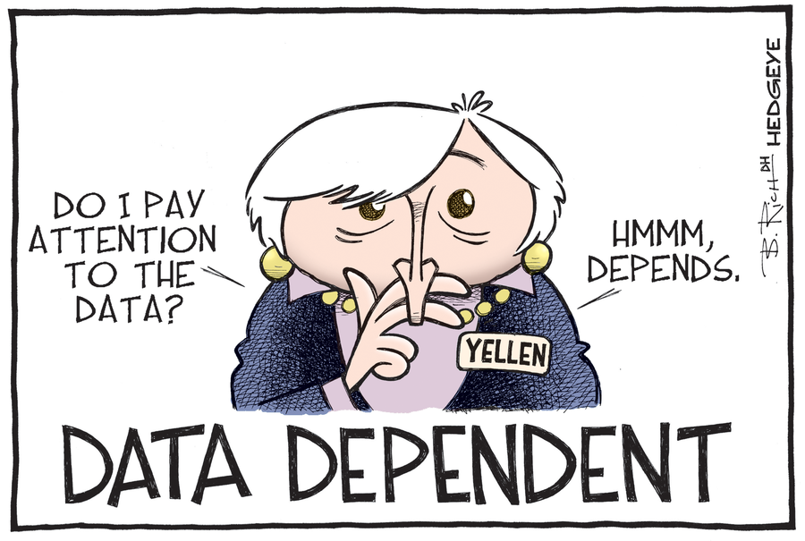
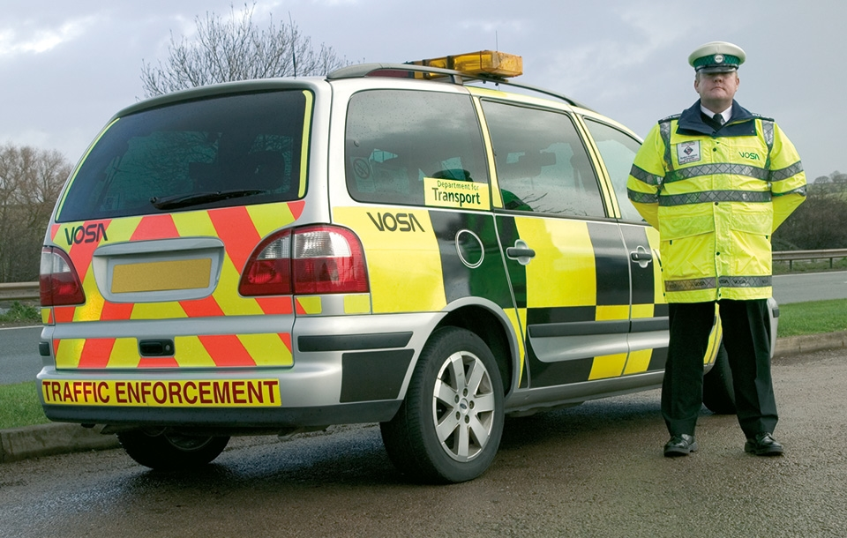
Constraint: Traffic ripple system
1- data dependent
the system only works if feed traffic data = {velocity, population, frequency}
2- specific end user
we only target the traffic ripple system only can be use by government or private traffic agencies. End user such public citizen may not be able to understand how the system works or found any useful from the system

Slide 24
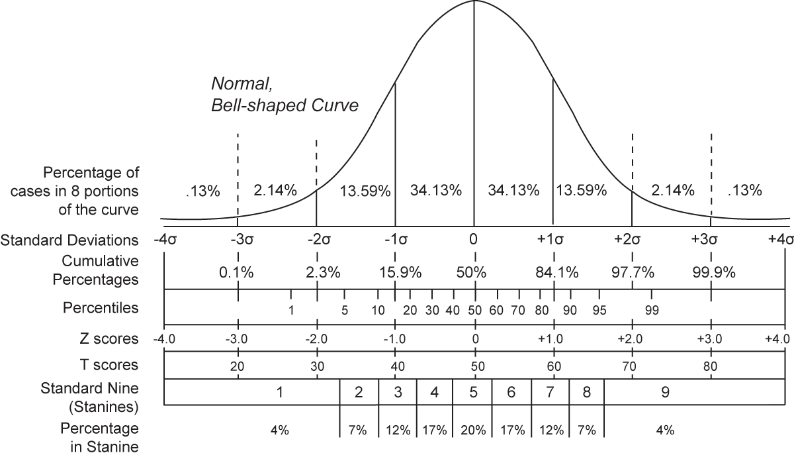
3- weak distribution
the traffic data may not have strong center distribution due to stochastic, because of this, the dispersion or confident intervals of traffic may not be able to predict

Slide 25
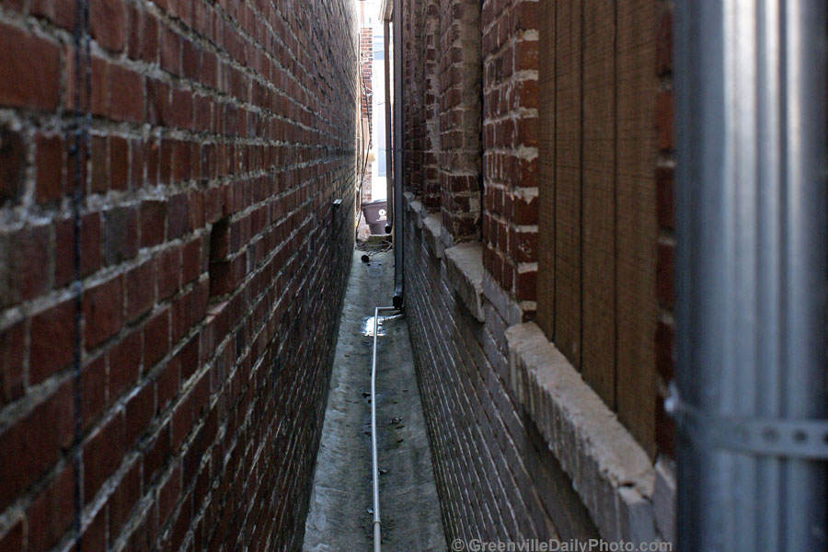
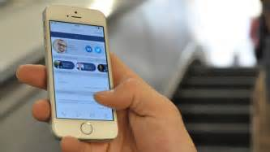
Constraint: Crowdsourcing system
1- Narrow system
it only be able to accept user details and send to cloud database. not more than that.
2- Facebook platform
Crowdsource must use Facebook platform to contribute useful data

Slide 26

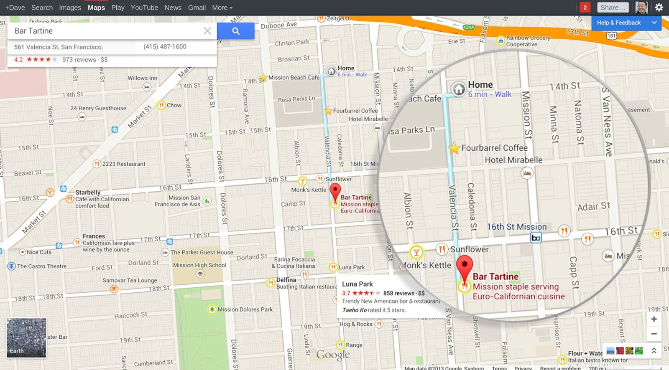

How is our development?
Front end engine: Javascript, and serverless.
Back end engine: PHP to read JSON, still serverless.
Geojson as basic map relation.
So when saying serverless, there are a lot of rest API we will use, fetching using AJAX, update dynamically without need to refresh the page.
1- Use Facebook Developer API to fetch useful data.
2- GoogleMap Engine to render digital map

Slide 27
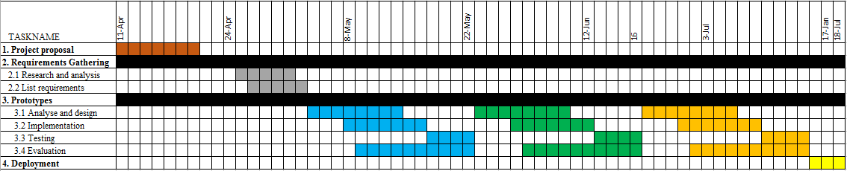
How is our software development?

Slide 28
Future works
Release an API for any pull request. Any agencies or authorized users able to get useful processed information from the ripple system.
Still calculating dynamically, store in JSON, accept request and sent, without need to use a server.
A lot of javascript rest API framework:
1- Webassembly
2- Google API JS

